Slide 1
Healthcare Insurance Big Data Analytics
CU BOULDER CSCI 5253 DATA CENTER SCALE COMPUTING PROJECT DEBUT
Mahin Kadabi, Naveenkumar, Vidit Sharma

Slide 2

INTRODUCTION
What is Big data?
Big data means different things for different industries. The definition also differs within an organization, across departments and management layers within IT and business.
The Big Data Institute (TBDI) defines big data as "term applied to voluminous data objects that are variety in nature - structured, unstructured or a semi-structured, including sources internal or external to an organization.

Slide 3
RELATED WORK
Healthcare data analytics, hospitals and clinics are looking for a new data mining techniques that will suite evolution of information technology and analyze a huge amount of complex data.
Advanced Data Visualization (ADV) - ADV is different from other standards bars and line chart, since it can scale its visualization for millions of data points, and handle different data types. ADV is easy to use and supports analysts to explore data widely. ADV can reduce quality problems which can occur when retrieving medical data for extra analysis.
Text Mining - Text Mining tools can be used and add a value in healthcare in terms of analyzing clinical records from the hospital emergency department

Slide 4
RELATED WORK(Cont.)
The Hadoop Distributed File System (HDFS) - HDFS enhances healthcare data analytics system by dividing large amount of data into smaller one and distributed it across the other systems.
Hive - is one of the programs developed in order to handle large amount of data, it’s is not processing and analyzing data quickly.

Slide 5
PROPOSED WORK
Big data storage and management - One of the most important elements in dealing with and managing data is to know where and how this data will be stored once when it is collected.
We propose to collect data from different resources, preprocess it with big data tools, compute and visualize the data.
Different data like patient name, age, sex are analyzed to check if the customer utilizing a particular insurance is accepted by the provider using Hadoop by different factors.
The healthcare provider can also understand which type of disease has maximum number of claims.

Slide 6
COMPONENTS TO BE USED
Linux
Hadoop
Spark
Sqoop
Python

Slide 7

APACHE HADOOP
Apache Hadoop is an open source framework that is used to efficiently store and process large datasets ranging in size from gigabytes to petabytes of data.
It consists of 4 main modules-
Hadoop Distributed File System (HDFS) – A distributed file system that runs on standard or low-end hardware.
Yet Another Resource Negotiator (YARN) – Manages and monitors cluster nodes and resource usage. It schedules jobs and tasks.
MapReduce – A framework that helps programs do the parallel computation on data. The map task takes input data and converts it into a dataset that can be computed in key value pairs. Hadoop Common – Provides common Java libraries that can be used across all modules.

Slide 8

APACHE SQOOP
What is Sqoop?
Apache Sqoop is a tool in Hadoop ecosystem which is designed to transfer data between HDFS (Hadoop storage) and relational database servers like MySQL, Oracle RDB, SQLite, Teradata, Netezza, Postgres etc.
It efficiently transfers bulk data between Hadoop and external data stores such as enterprise data warehouses, relational databases, etc.
Sqoop transfer data between hadoop and relational DB servers.
Sqoop is used to import data from relational DB such as MySQL, Oracle.
Sqoop is used to export data from HDFS to relational DB.

Slide 9

APACHE SPARK
Apache Spark is an open-source unified analytics engine for large-scale data processing. Spark provides an interface for programming clusters with implicit data parallelism and fault tolerance.
It provides high-level APIs in Scala, Java, Python, and R, and an optimized engine that supports general computation graphs for data analysis.

Slide 10
DATA FLOW ARCHITECTURE
The Linux file server receives data files in form of json and csv.
After validated the files data, we will store the files data into the RDBMS.
After storing the data into the RDBMS, we transform the data.
After the data is sent to HDFS, it will be used for EDA and analyzing customer data for the healthcare providers.
After analyzing, we will test the result and prepare visualizations to support our conclusion.

Slide 11
EVALUATION
To evaluate our project, we will analyze our data by creating different visualizations. This will give the ability for the healthcare provider to understand the behavior of the customers.
Healthcare providers can then use this data to deliver offers and royalties to clients to improve their revenue-generating tactics
The main activities of this stage are predicting future events, identifying trends and determining the probabilities of uncertain events.

Slide 12
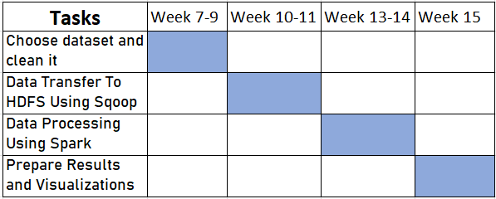
MILESTONES

Slide 13
Thank You

